Slide 1


Wild Teaching
Paul O’Donnell
St. Patrick’s N.S., Slane, Co. Meath
Meath County Council
The Heritage Council

Slide 2
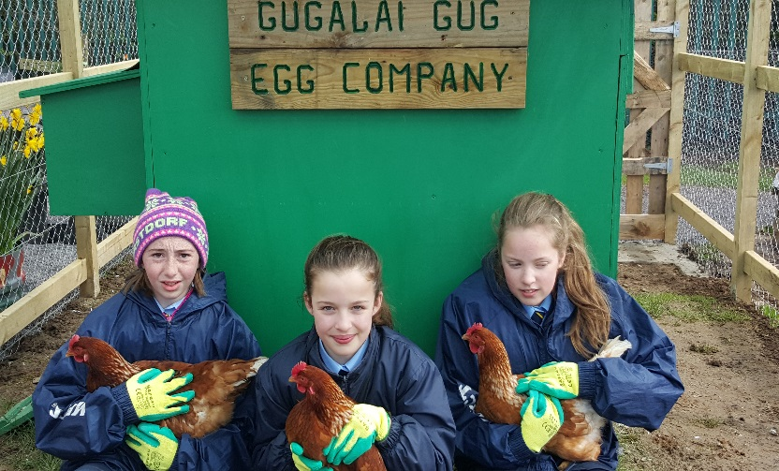
Why Take Teaching
& Learning Outdoors?
Learning connections to the primary curriculum
Skills like problem solving, working collaboratively & turn taking
Connection with & respect for the world
Where food comes from
Develop fine and gross motor skills
Have fun!

Slide 3
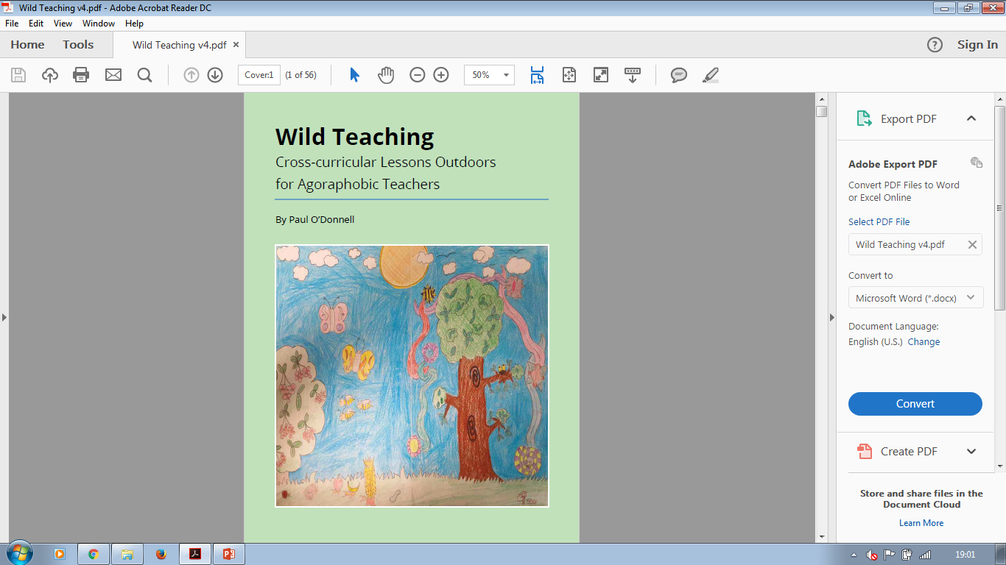

Slide 4
Notes On The Book
There is one lesson per week for the school year
No garden or specific space is needed
The lessons mainly cover science but also maths, literacy, visual arts, history and geography
I have taught all the lessons with pupils from junior infants to sixth class
I always put the resources needed on the board on a Monday for the pupils to take in. The lesson happens if the resources arrive by the day that it is due to be taught.

Slide 5
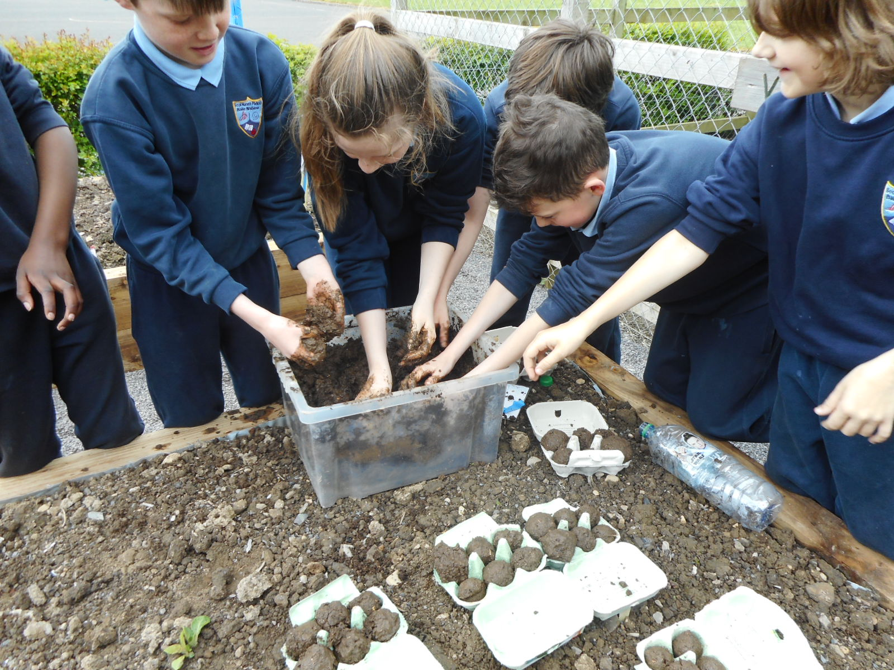
A Lesson Outdoors
50 mins long
10 minutes introduction
10 minutes nature walk
20 minutes outside
(in stations writing/active)
10 mins back inside for revision & wash hands
Record subjects, strands & strand units
in your planning notes

Slide 6
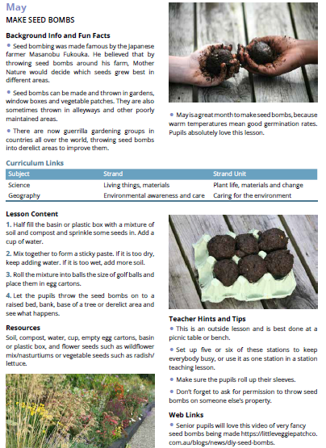
Sample Lesson Layou
May Seed Bombs
Images
Background
Information
Curricular
Links
Lesson Content
Step by Step
Teacher
Hints & Tips
Resources
Needed
Online Video
& Web Links

Slide 7

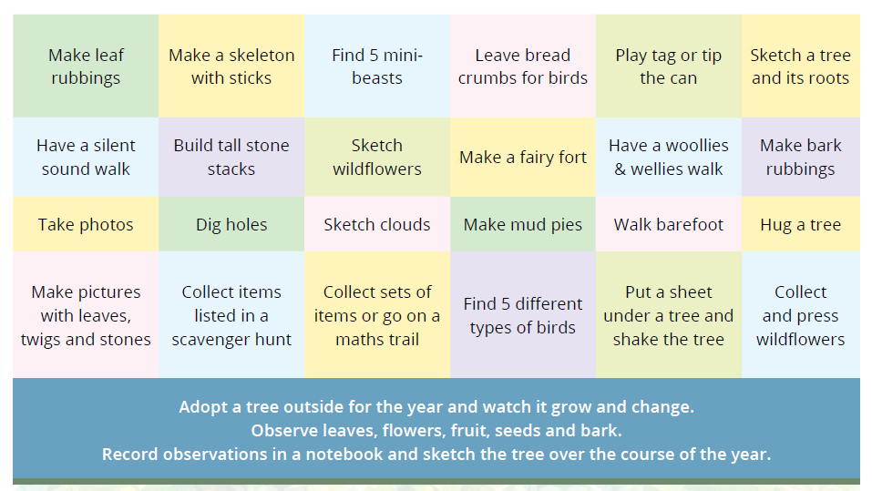

Slide 8
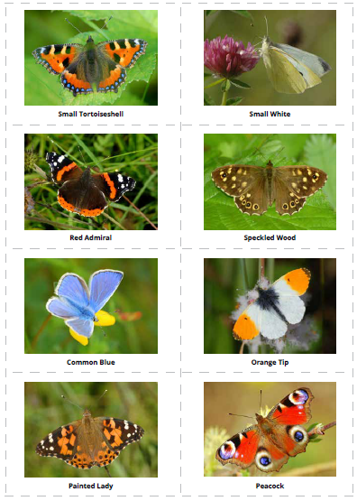
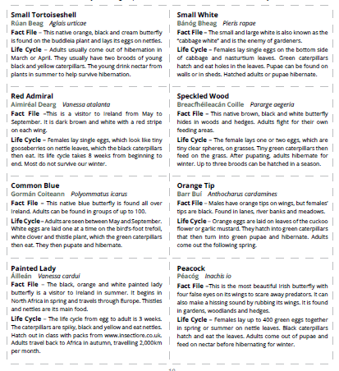
Matching Sets of Butterflies, Tree Leaves, Birds, Mini-beasts & Wildflowers

Slide 9
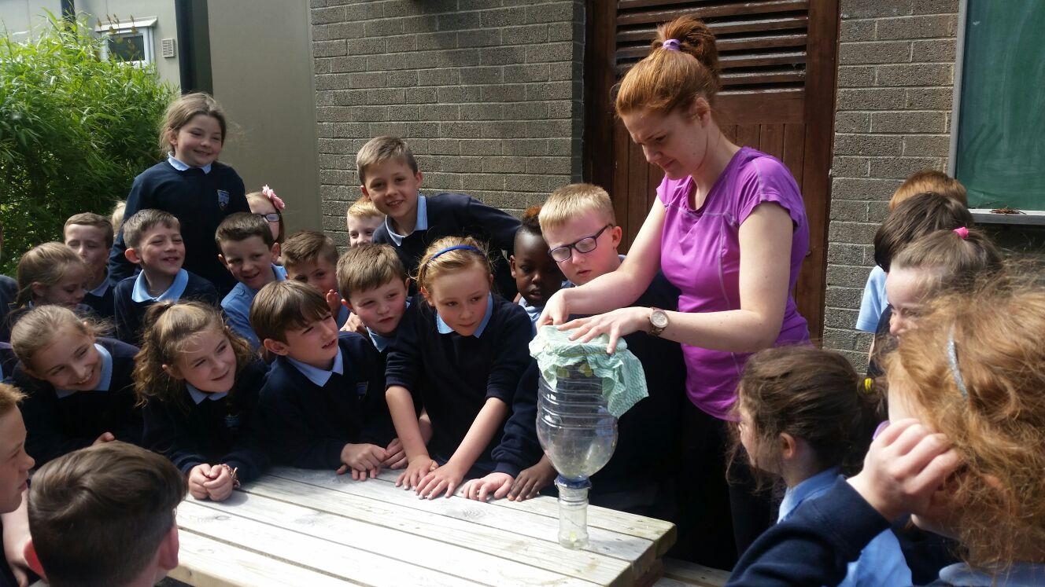
Sample Lessons –
Hatching Butterflies

Slide 10
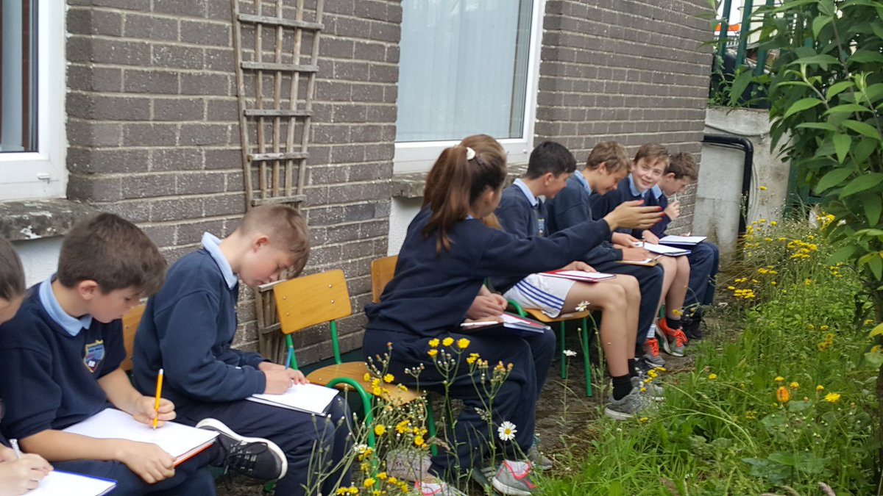
Sample Lessons –
Sketching Wildflowers

Slide 11
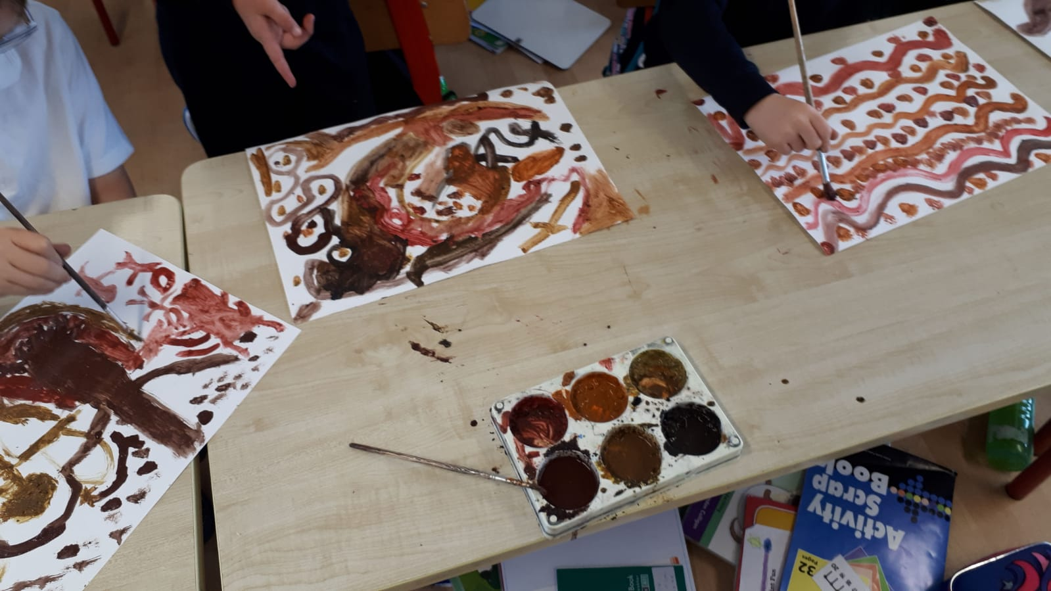
Sample Lessons –
Muck Painting

Slide 12
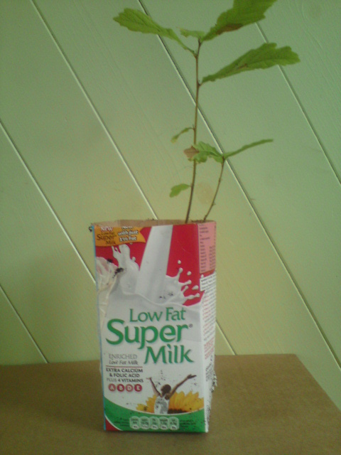
Sample Lessons –
Planting Trees

Slide 13
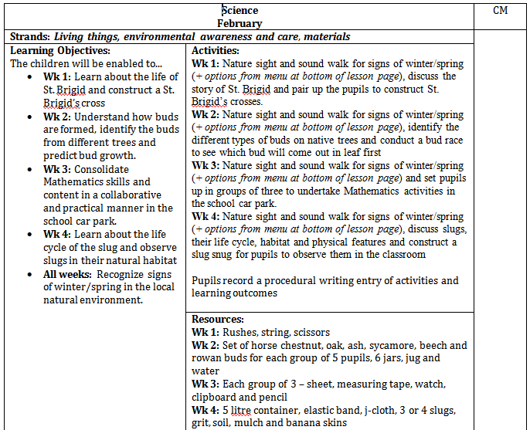
Planning Notes
Planning notes for all lessons, which are available to copy and paste into fortnightly planning notes are available at http://www.meath.ie/CountyCouncil/Heritage/HeritageinSchools/WildTeachingPlanningNotes/

Slide 14
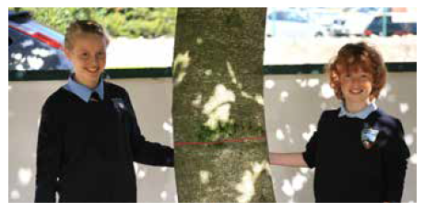


Wild Teaching
Free copy for every primary teacher in Co. Meath
€10 including p&p for those outside Co. Meath!
For further information, contact:
heritage@meathcoco.ie
donegalpaul@hotmail.com
@DonegalPaul9

