Slide 1
But it rains in Ireland!
We gathered the hourly rainfall data for the 2021-2023 academic years.
We removed the summer months so these good weather holidays would not skew the picture.
We also removed Saturdays and Sundays.
We then narrowed the hours down to those around school start and finish times, the hours during which we’d be most likely to be commuting to and from school.
What did we find?
2021 - 2022
Sept | Oct | Nov | Dec | Jan | Feb
Mar | Apr | May | Jun | Jul | Aug
2022 - 2023
Sept | Oct | Nov | Dec | Jan | Feb
Mar | Apr | May | Jun | Jul | Aug
Monday | Tuesday | Wednesday | Thursday
Friday | Saturday | Sunday
8-10 | am | 12-4 | pm

Slide 2
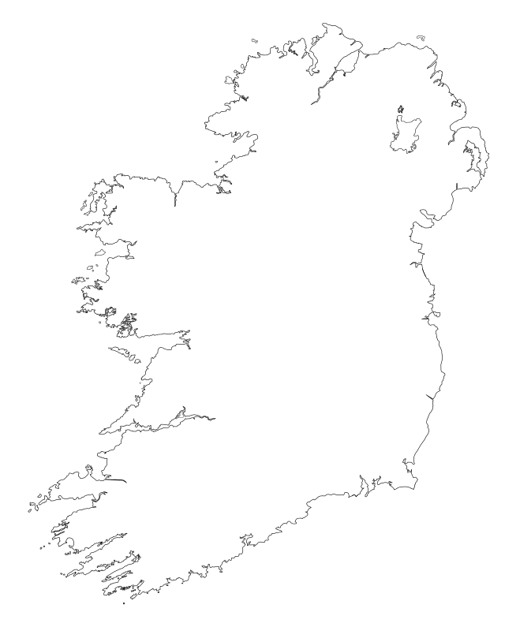

Where is Meath, Dunsany weather station?
For Meath, Dunsany weather station, which is located here…

Slide 3
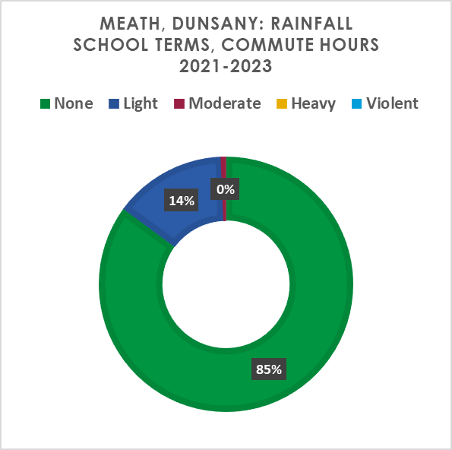
Rainfall: Meath, Dunsany
Over the 2,730 commute hours included in this analysis it didn’t rain at all during 85.1% of commute hours.
For 12.59% of these hours there was light rain recorded.
There were only 12 hours during which moderate rain was recorded, this came to 0.57%.
Heavy and violent rainfall was not recorded at all.
Light | 0.1mm | to | 2.4mm | per hr
Moderate | 2.5mm | to | 0.9mm | per hr
Heavy | 10mm | to | 49mm | per hr
Violent | >49mm |  |  | per hr

Slide 4
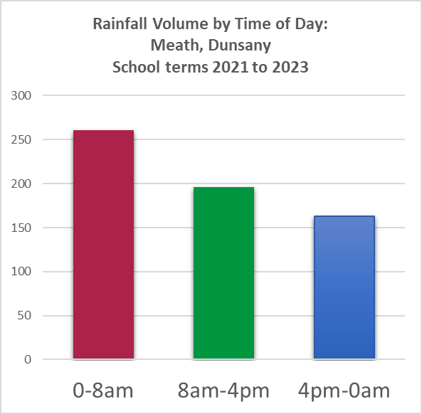
Rainfall: Meath, Dunsany
We can see now that it indeed rains a lot in Ireland, but the rain kindly tends to fall when we’re not on our way to and from school.
This chart also explains why the world almost always seems to be wet when we leave the house in the morning: it’s wet from overnight rainfall, you’ll seldom get wet on your commute.
Notes:
Edit note: paste chart in as image.

Slide 5
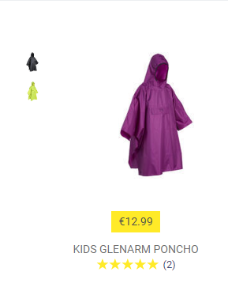
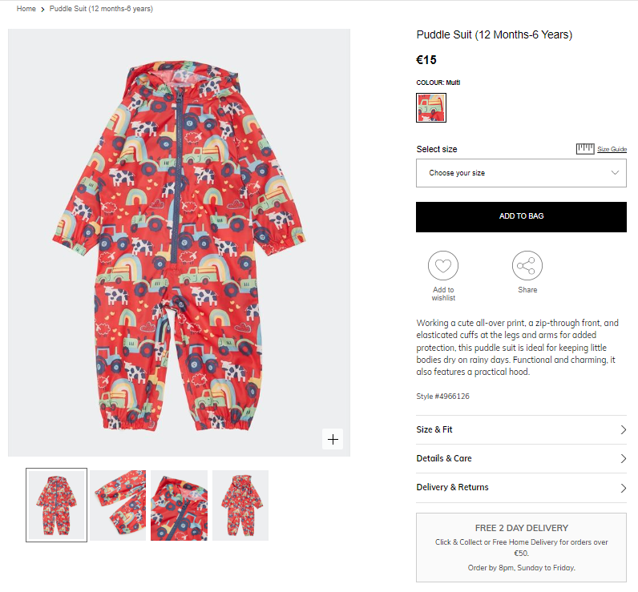
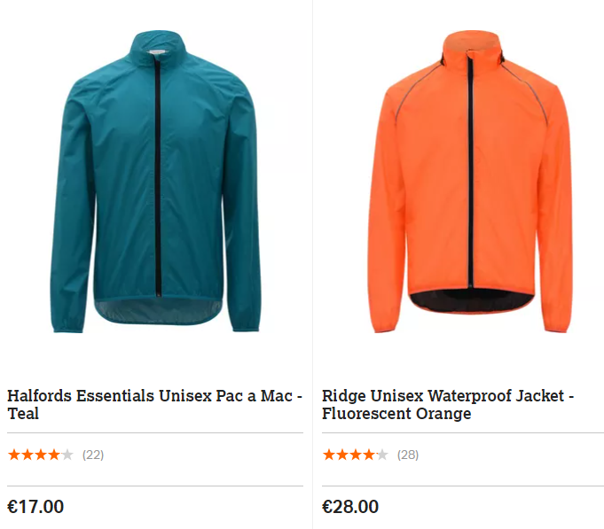
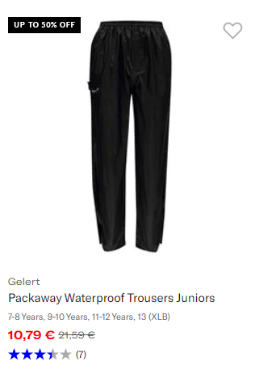
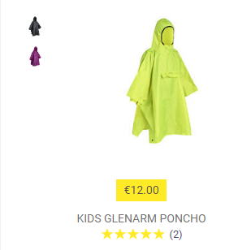
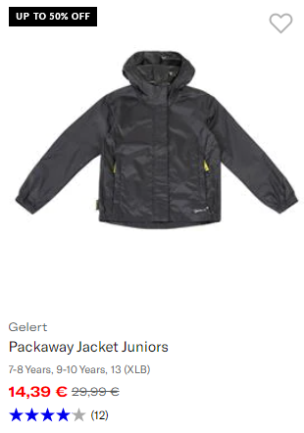
But what about when it DOES rain?
Rain suit
Rain Jacket
Poncho
Dunnes, Sports Direct
Halfords
Decathlon
Notes:
There are a few different rain gear options you can try out to see what suits you best. Places like Screwfix sells full waterproof suits in adult sizes for as little as €13. The examples on the screen are for children, and are from Dunnes and Sports Direct. Halfords has very good jackets for reasonable prices in their cycling section. Try a poncho if you really don’t want to get wet, because it can keep your whole body and perhaps a backpack dry, too. The examples there are from Decathlon. You can get even cheaper ponchos but they tend not to last.

