Slide 1


Ashbourne SEC
Energy Master Plan (EMP)
January 2025
Michael Hanratty, Keer Xu & Jose Ramirez
IHER Energy Services Ltd.
michael@iher.ie

Slide 2
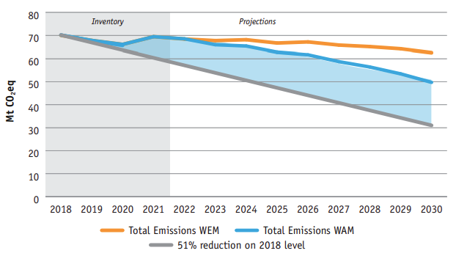

Total Greenhouse Gas Emissions With Existing Measures (WEM) and With Additional Measures (WAM) scenarios out to the year 2030
Ireland’s Climate Action Plan set target of 51% reduction in Greenhouse Gas Emissions by 2030 from 2018 baseline
Gap exists between (With Additional Measures scenario) projections and the 51% target. Source: Ireland’s greenhouse gas emissions projections 2022-2040 (EPA, 2023)
Notes:
https://www.epa.ie/publications/monitoring--assessment/climate-change/air-emissions/EPA-GHG-Projections-2022-2040_Finalv2.pdf
Land Use, Land Use Change and Forestry (LULUCF)
With Existing Measures (WEM)
The WEM scenario is a projection of future emissions based on the measures currently implemented and actions committed to by Government. To become part of the WEM scenario a policy or measure must be in place by the end of 2021 (the latest inventory year) and the projected emissions reduction is commensurate with the resources or legislation already in place or committed to Government Departments or Agencies. For example, the WEM scenario includes a measure where the Carbon tax increases annually and reaches €100 per tonne by 2030. This policy is considered to be implemented because annual carbon tax increases have been committed to in legislation (Finance Act 202015).
With Additional Measures (WAM)
The WAM scenario is the projection of future emissions based on the measures outlined in the latest Government plans at the time Projections are compiled. This includes all policies and measures included in the WEM scenario, plus those included in Government plans but not yet implemented. For example, the WAM scenario includes the target of 945,000 Electric Vehicles on the road by 2030 in the Climate Action Plan 2023. The full amount of this ambition is not currently in the With Existing Measures scenario as actions still remain to be taken that would deliver it. nual carbon tax increases have been committed to in legislation (Finance Act 202015).

Slide 3
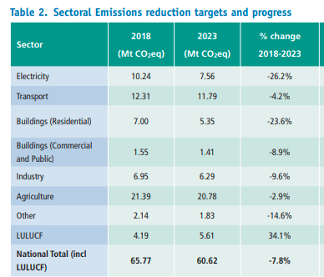
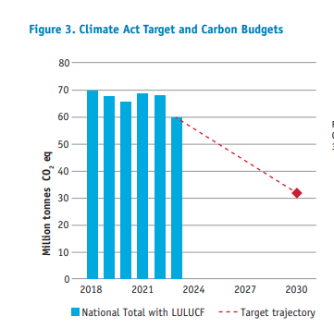
Progress from 2018 - 2023
By end of 2023, a 7.8% reduction had been achieved from the 2018 baseline.
So, a big gap must be bridged by 2030.
(Source: EPA-Provisional GHG Report-July 2024)
LULUCF: land use, land use change, and forestry
Notes:
https://www.epa.ie/publications/monitoring--assessment/climate-change/air-emissions/EPA-GHG-Projections-2022-2040_Finalv2.pdf
Land Use, Land Use Change and Forestry (LULUCF)
With Existing Measures (WEM)
The WEM scenario is a projection of future emissions based on the measures currently implemented and actions committed to by Government. To become part of the WEM scenario a policy or measure must be in place by the end of 2021 (the latest inventory year) and the projected emissions reduction is commensurate with the resources or legislation already in place or committed to Government Departments or Agencies. For example, the WEM scenario includes a measure where the Carbon tax increases annually and reaches €100 per tonne by 2030. This policy is considered to be implemented because annual carbon tax increases have been committed to in legislation (Finance Act 202015).
With Additional Measures (WAM)
The WAM scenario is the projection of future emissions based on the measures outlined in the latest Government plans at the time Projections are compiled. This includes all policies and measures included in the WEM scenario, plus those included in Government plans but not yet implemented. For example, the WAM scenario includes the target of 945,000 Electric Vehicles on the road by 2030 in the Climate Action Plan 2023. The full amount of this ambition is not currently in the With Existing Measures scenario as actions still remain to be taken that would deliver it. nual carbon tax increases have been committed to in legislation (Finance Act 202015).

Slide 4
Ashbourne EMP Study Objective
The Government’s Climate Action Plan (2024) CAP 2024 re-establishes the target to achieve a 51% reduction in (GHG) emissions by 2030 from the 2018 baseline.
Ashbourne EMP presents a local energy model and local emissions reduction target & plan.
Baseline Study
current energy demand across residential, commercial, public buildings and transport
Energy Audits
3 public buildings and 7 house types
2030 EMP
Targets and Roadmap

Slide 5
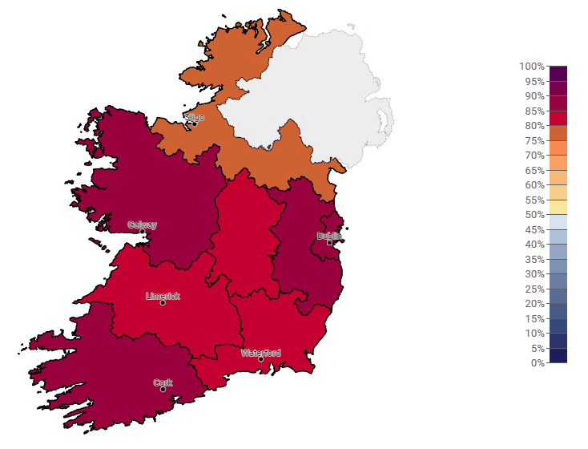
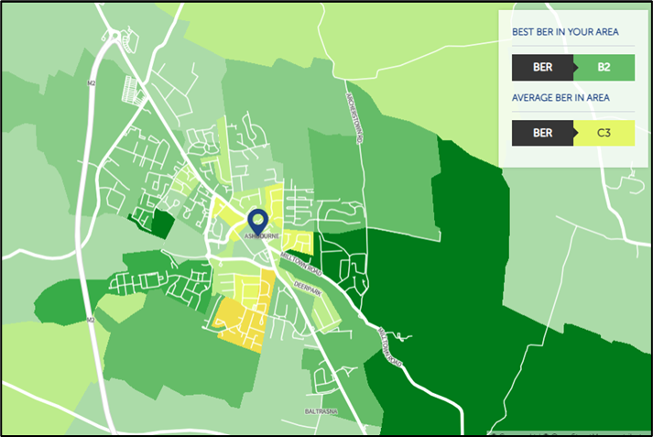
Residential Emissions
Ashbourne
5986 dwellings & 40% (2958) have BERs
Average BER is C1
C1
D

Slide 6
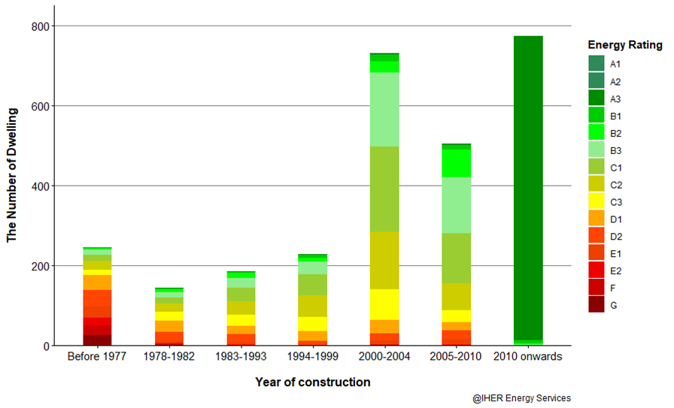
Residential Baseline – Total Stock BER Scores

Slide 7

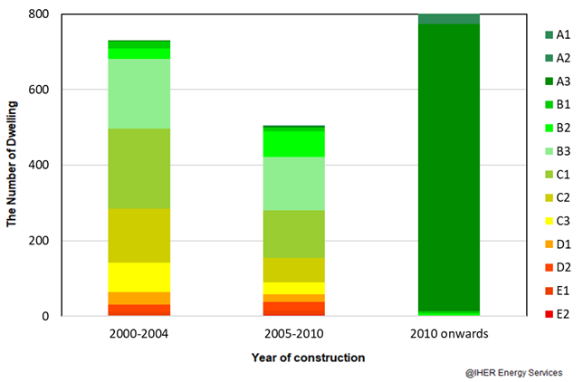
Residential Baseline – Total Stock BER Scores
About 73% (2,381) of dwellings with published BER built from 2000 onwards
2000 onwards (2381):
B2 or better: 37% (1102)
C3 – B3 : 34% (1000)
D: 10% (301)
E or worse: 5% (146)

Slide 8
Residential Baseline – Residential Main Heating
Heat Pump
15%
0.4%
210
Electric Heating
236
Electricity
Solid Fuels
Condensing Boiler
74%
11%
1668
844
Non-Condensing Boiler
Natural Gas
Heating Oil
(BER Database, 2023)
(Census, 2022)

Slide 9
Residential Baseline – Heat Pumps Ready? pre 2000
Pre 2000:
89 dwellings with HLI < 2
167 dwellings HLI = 2–2.3
But only 12 dwellings with heat pump installed.
Approx. 244 dwellings with BERs are “heat pump ready” (HLI below 2.3).

Slide 10
Residential Baseline – Heat Pump Ready? 2000 +
2000 onwards:
1616 dwellings with HLI < 2
308 dwellings HLI = 2 –2.3
But only 198 dwellings with heat pump installed.
Approx. 1726 dwellings of 2000 onwards with BERs are “heat pump ready” (HLI below 2.3).

Slide 11
Residential Baseline – “Heat Pump ready” houses
6 %
12 Heat pumps in pre 2000 houses
94 %
210
198 Heat pumps in 2000 onwards houses
Approx. 1,970 dwellings in Ashbourne with BERs are “heat pump ready” (HLI below 2.3).

Slide 12
Residential Baseline Results
Inputs
Outputs
Dwellings
5,896
Total Primary Energy
105,439,200 kWh
Average Primary Energy per dwelling
17,883 kWh/annum
Analysis
CO₂
26,001 tonnes
Annual Residential Energy Costs
€ 22,404,800
Annual Energy Bill
€ 3,800

Slide 13
Commercial / Public Buildings Baseline Results
Inputs
Outputs
96 Small businesses
160 Medium businesses
29 Large businesses
3 Energy audits of business premises
(St Declan’s National School, REM, Hugh Maguire Butchers)
Total Primary Energy
146,833,810 kWh
Analysis
CO₂
34,197 tonnes
Energy bills from audits & SEAI annual estimates
Annual Business Energy Costs
€17,873,113

Slide 14
Transport Baseline Results
Inputs
Outputs
Car Split (Dept of Transport- 2022):
3,049 Petrol
4,805 Diesel
662 BEVs
8,516 Total
Total Primary Energy
96,415,260 kWh
Analysis
CO₂
22,517 tonnes
National Annual Average
12,113 km Petrol
19,681 km Diesel
12,958 km BEVs
Annual Transport Costs
€19,396,696
Note: 1000 kg CO2 = 1 Tonne CO2
National statistics based on average distances travelled, kWh/km and gCO₂/km

Slide 15
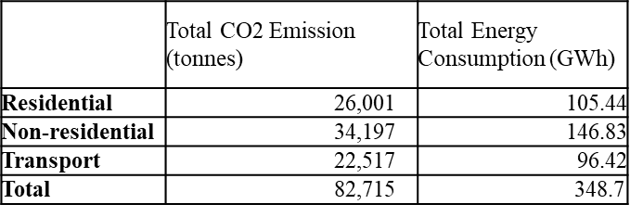
Athboy Summary Baseline - 2023
Baseline is 82,715 tonnes CO₂ and
348.7 GWh energy per annum in 2023

Slide 16
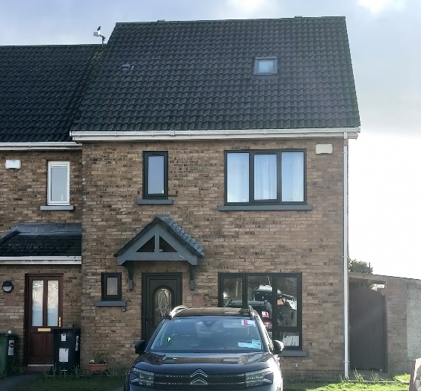
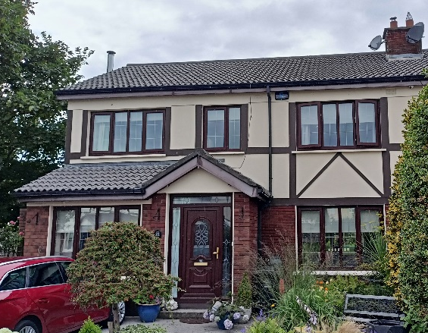

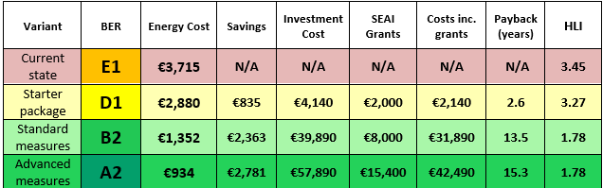
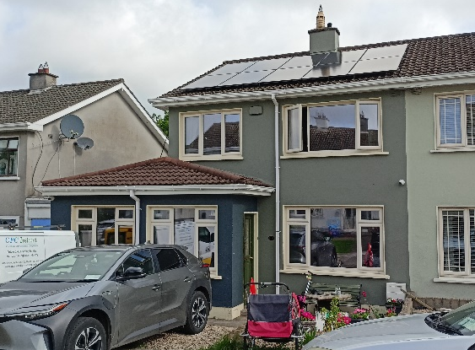
Audits - 7 x Residential Survey & Analysis
Note: Heat loss indicator (HLI) must be <=2.3 to qualify for SEAI Heat Pump grant
Starter: roof insulation, heating controls
Standard: + external/internal wall insulation, condensing boiler & stove
Advanced: + external/ internal wall insulation, double glazed windows, heat pump, stove, whole house ventilation

Slide 17
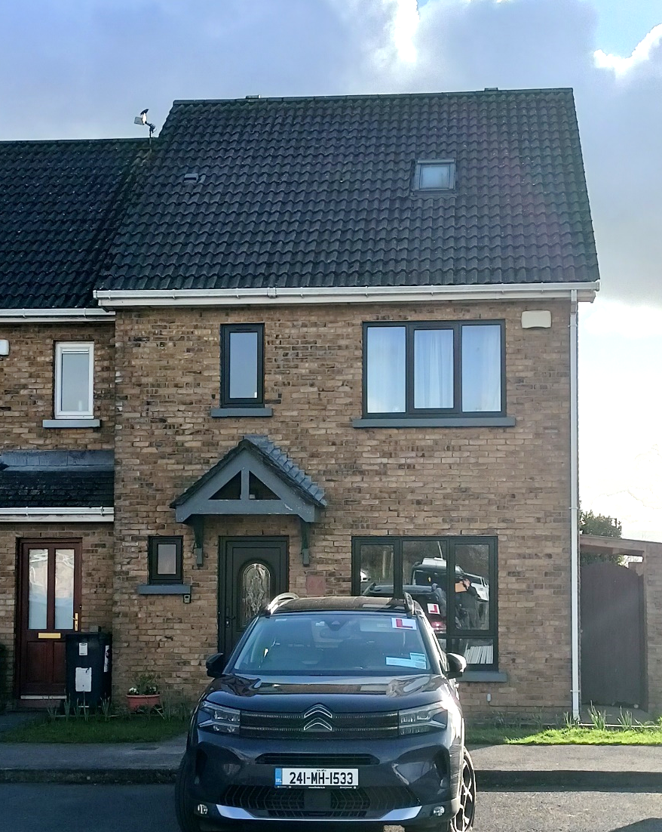
Residential Survey – Brindley Park
PV panels (2 kW)
300mm attic insulation, sloping roof insulation (U=0.20)
Low energy lights
New double glazed low-e windows (U=1.4)
Cavity wall insulation (U=0.35)
Air to water heat pump, (including full heating controls)

Slide 18
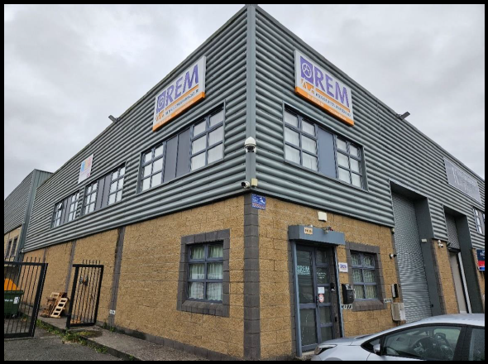
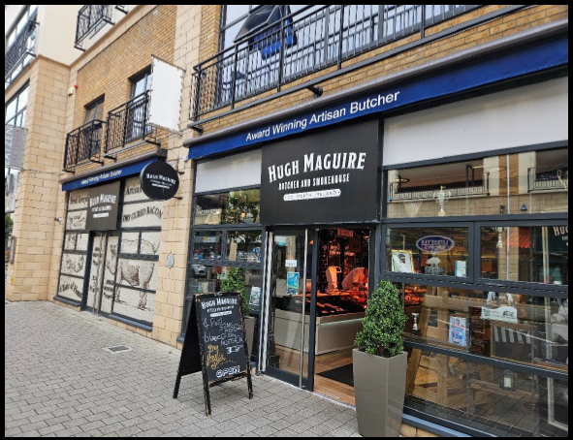
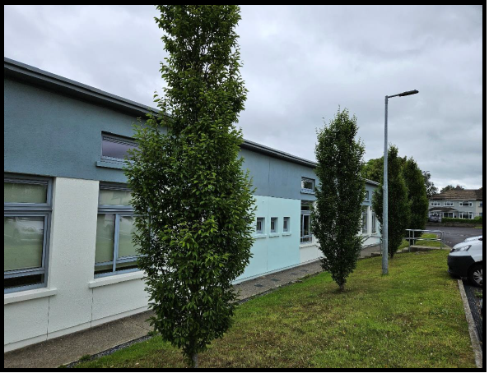
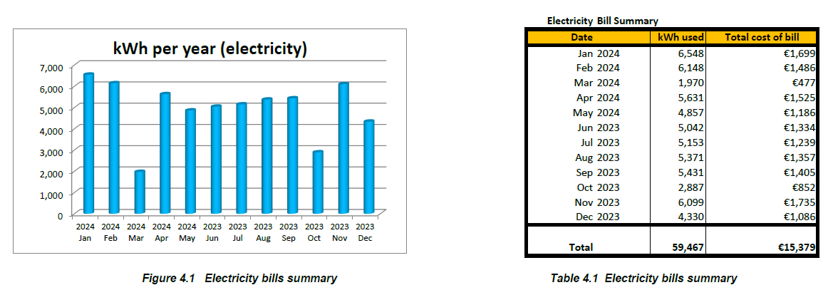
–
Audits – 3 Commercial buildings
(Codex, 2024)

Slide 19

Residential Upgrade Scenario (2024-2028)
A1
  Category 4A- Advanced measures (Standard with heat pump and whole house ventilation) & PV – 100 homes
  Category 5A - Heat pump &PV only -2011 onwards – 100 homes
A2
  Category 4A- Advanced measures (Standard with heat pump and whole house ventilation) & PV – 100 homes
  Category 5A - Heat pump &PV only -2011 onwards – 100 homes
A3
  Category 3A - Standard measures package (roof insulation, internal or external wall insulation, boiler and heating controls , wood stove) & PV – 150 homes
  Category 4 - Advanced measures (Standard with heat pump and whole house ventilation) – 200 homes
  Category 5 - Heat pump only -2001-2010 – 300 homes
B2
  Category 1 – PV only – 250 homes
  Category 2A – Roof insulation, heating controls &PV – 75 homes
  Category 3 - Standard measures package (roof insulation, internal or external wall insulation, boiler and heating controls, wood stove) – 150 homes
B3
C1
  Category 2 – Roof insulation and heating controls: 2001-2010– 50 homes
Assumption: 30% of dwellings will be upgraded in next 5 years
  Category 2 – Roof insulation and heating controls: 1981-2000 – 100 homes
D1
  Category 2 - Roof insulation and heating controls: pre 1980 – 75 homes

Slide 20
Impact of De-carbonising Electricity in Ireland
CO2 Emission (kg/kWh)
32% all electricity generated in 2019 was from wind and avoided 3.9 million tonnes of CO2 emissions. 4,332.5 MW Installed capacity in Ireland as of May 2022. (SEAI, 2023)

Slide 21
Residential – Energy Reduction Model (2023-2033)
This upgrade plan is equivalent to a 2% annual reduction in energy usage.
When accounting for the ongoing decarbonisation of electricity, there will be a 19% reduction by 2028 & 34% by 2033.
-4% -8% -11% -15% -19% -22% -25% -28% -31% -34%

Slide 22
Non-domestic Buildings Energy Model
3% reduction in Commercial/ Public Building Energy Usage
-3% -6% -9% -11% -14% -17% -19% -22% -24% -26%
*** All public buildings and businesses in Ashbourne need to develop energy and carbon reduction plans

Slide 23
Transport Projections to 2033
Assume 29.5% EV Market Share by 2030
3.75% reduction in Car Transport Energy Usage
Notes:
Cannot find this table from the Marino folder

Slide 24
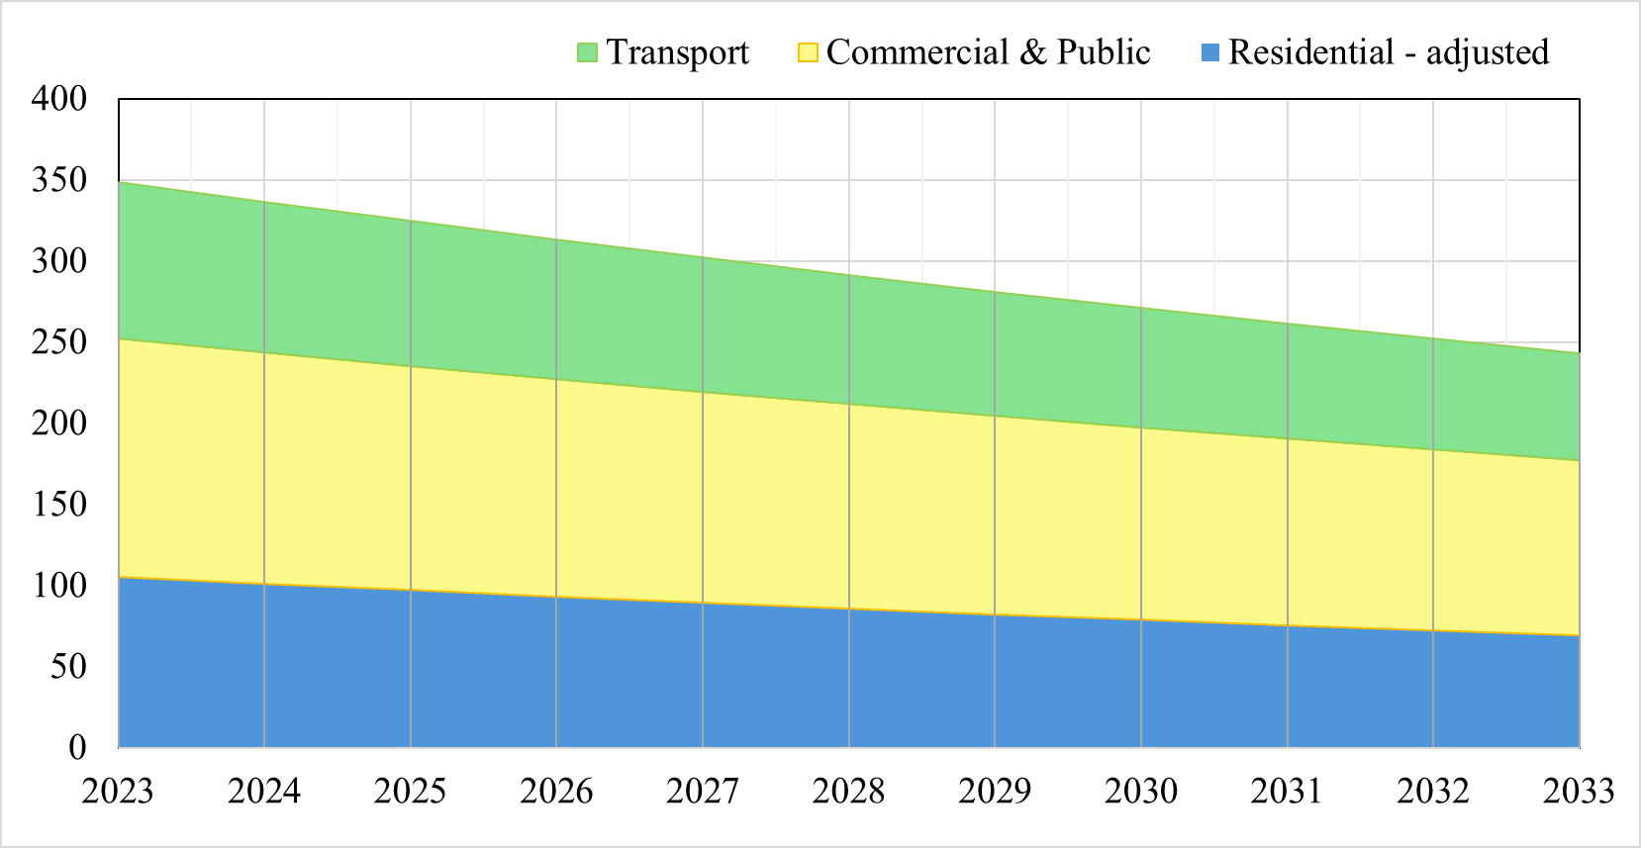
Ashbourne SEC Energy Reduction Projection
– All Sectors (2023-2033)
3%
7%
10%
13%
16%
19%
22%
25%
28%
30%
Notes:
Option 2

Slide 25
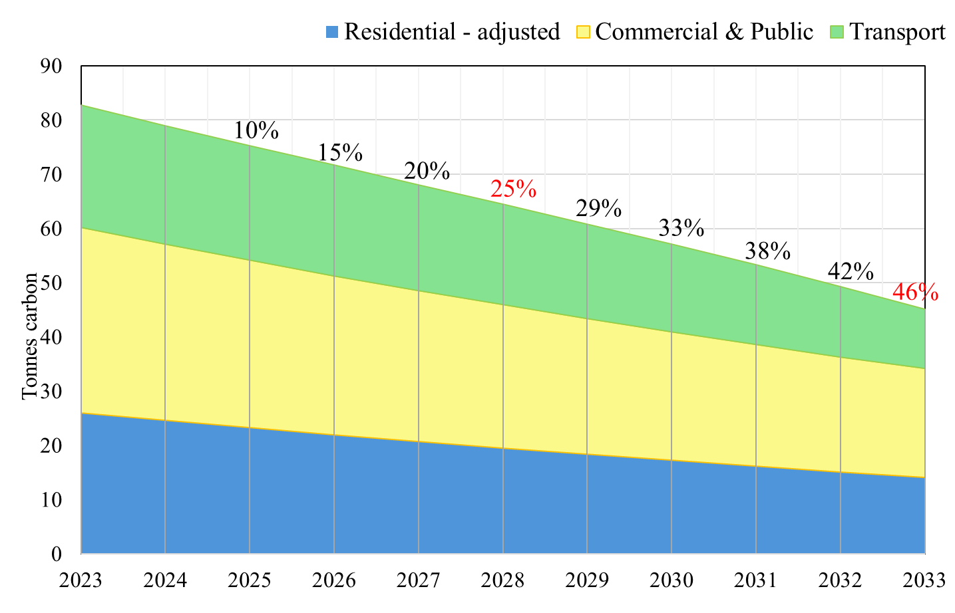
Ashbourne SEC Carbon Reduction Projection
– All Sectors (2023-2033)
Notes:
Option 2

Slide 26
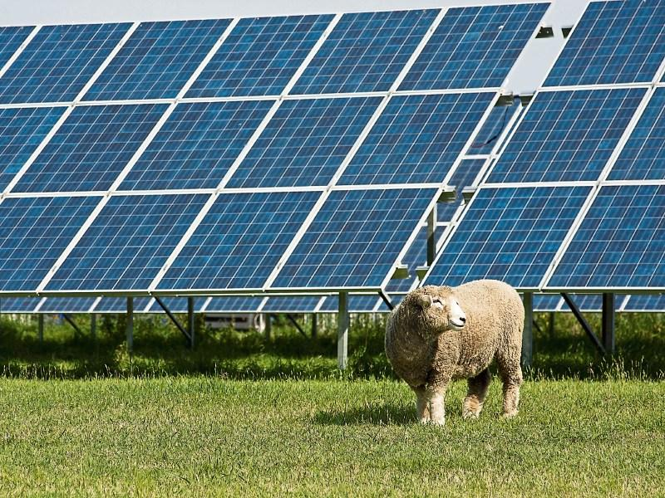
Solar Farms
One gigawatt (1GW) of solar PV power is deemed enough to power 750,000 homes.
With 268 MW equal to 0.268 GW, the ten Ashbourne solar farms will have capacity to power 200,00 homes, just shy of the total of 220,000 homes for all of County Meath (Census 2022).

Slide 27
Key Takeaways
Every energy saving & carbon reduction measure is valuable
Encourage homeowners to consider developing their own 5 or 10-year plan to reduce energy and carbon for their home
Business owners and public building managers need to buy into the Energy Master Plan goals for Ashbourne
Encourage business owners and public building managers should report on annual energy use and conduct energy audits. Also develop a 5-year energy and CO₂ reduction plan for their businesses
Engage directly with One Stop Shop providers if proceeding with deep retrofits

