Slide 1






Community Climate Action Programme
Information Session
Wednesday 23rd July 2025

Slide 2
Agenda
  Overview of the Community Climate Action Programme (CCAP)
  Main Objectives of the Grant
  Eligibility Criteria – Who Can Apply
  Project Themes and Descriptions
  Delivering Direct Positive Impact / Types of Projects Funded
  Application Process Overview and x3 Grant Sizes Available
  Community Climate Action Officer Contact Details
  Examples of Community Projects Awarded in Phase 1

Slide 3
Overview of the Grant
Launched as part of the Government's wider efforts under the Climate Action Fund, the Community Climate Action Programme (CCAP) began to be formally announced and rolled out in the latter part of 2023 and into early 2024.
Strand 1:
Building Low Carbon Communities
Strand 1a:
Supports Cross-Border and All-island Projects
Projects from Phase 1 of the CCAP are now in delivery.
The projects will be completed over an 18-month timeframe.
LA Allocations and list of projects www.gov.ie - DECC - Publications - Climate Action Fund

Slide 4
Main Objectives of the Grant
Empowering Communities
Supporting local, community-led climate action initiatives.
Capacity Building and Learning
Build capacity and knowledge within communities to address climate change.
Reducing Greenhouse Gas Emissions
Funding projects that contribute directly to Ireland's emission reduction targets.
Flexibility and Innovation
Communities develop innovative solutions to challenges they face locally.
Building Low Carbon Communities
Supporting the transition towards more sustainable practices at a local level.
Emphasis on Local Authority Partnership
Ensures projects are aligned with local climate action plans.

Slide 5




Who can apply?
Community groups who are:
Not for profit
Located in the operational area of the local authority
Registered with their local PPN, or connected to a collective such as "The Wheel" / Tidy Towns, and / or by a community group with Articles of Association or a Constitution, have held an AGM, and have approved minutes for same.

Slide 6
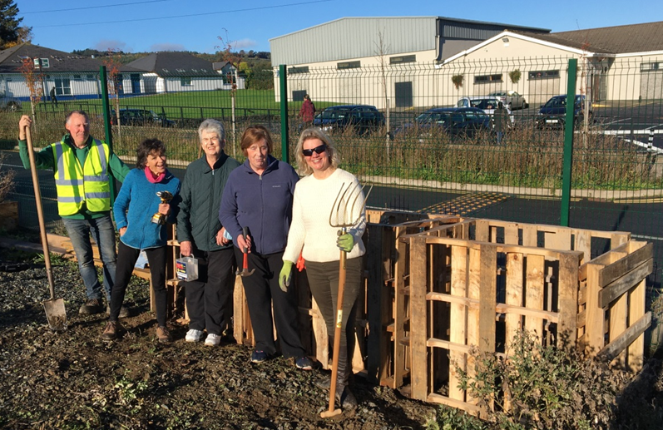
Community groups such as:
  Tidy Towns Committees
  Sports Clubs
  Residents Associations
  Men's / Women's Sheds
  Environmental / Biodiversity Action Groups
  Community Development Groups / Associations

Slide 7
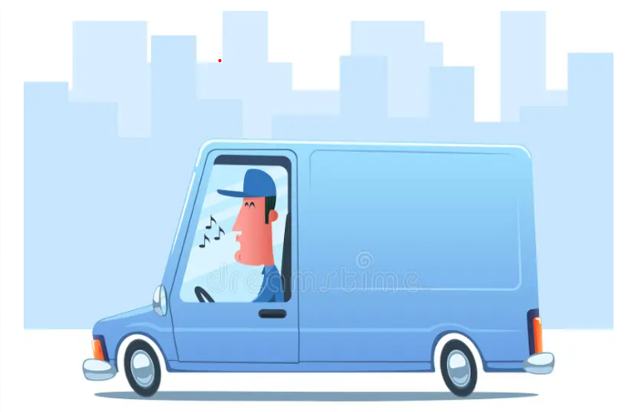
Who Can NOT Apply
Private individuals
Commercial entities (including sole traders)
Schools
National community or environmental groups

Slide 8
Projects Eligible for Funding
The types of projects/initiatives, within communities, should seek to demonstrate potentially innovative solutions to address.
Reduction of greenhouse gas emissions
Increasing the use of renewable energy
Improving energy efficiency
Increasing climate resilience
Identifying nature-based projects that enhance biodiversity
Assisting regions in the transition to a low carbon economy

Slide 9

Project Themes
One Project per community group
Project must address at least one of the 5 themes
Project can address more than one of the 5 themes

Slide 10
Types of Projects Funded
Community Energy
LED Community Lighting
Retrofitting of Buildings ( Fabric)
Renewable Energy Projects i.e. Solar, Wind
Travel
Safe Active Travel access
Cycle Parking
Improving access to cycle paths
Food & Waste
Community Gardens
Allotments
Food Pledges
Commmunity Food Markets
Community Composting
Repair Hubs
Shopping & Recycling
Upcycling Hub
Swap shops
Water Refill Stations
Reducing, reusing & Recycling initiatives
Local Climate & Environmental Action
Mini Forest
Dispersed Orchards
Pollinator Projects
Climate Resilient Projects

Slide 11
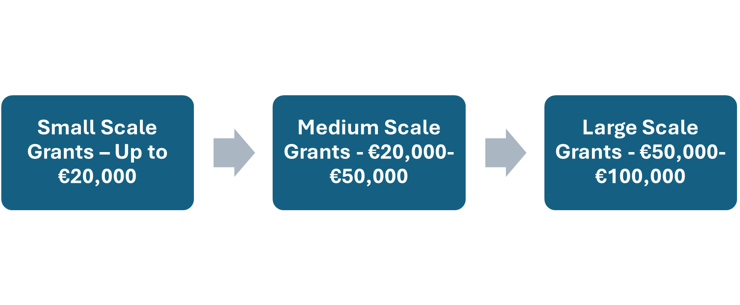
Application Process Overview
- Grant Sizes

Slide 12
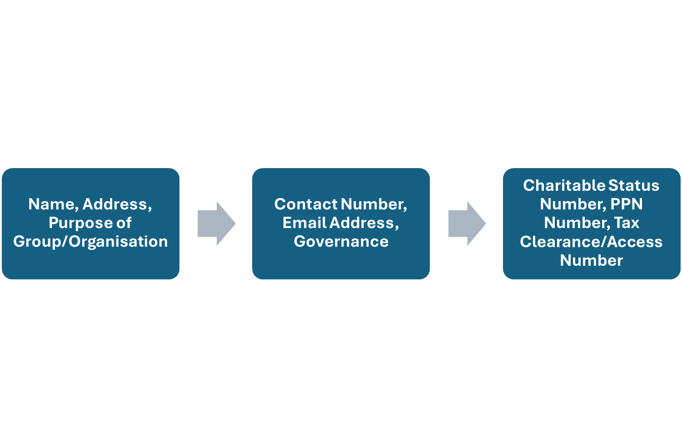
Application Process Overview
- Tell us about your group/organisation

Slide 13
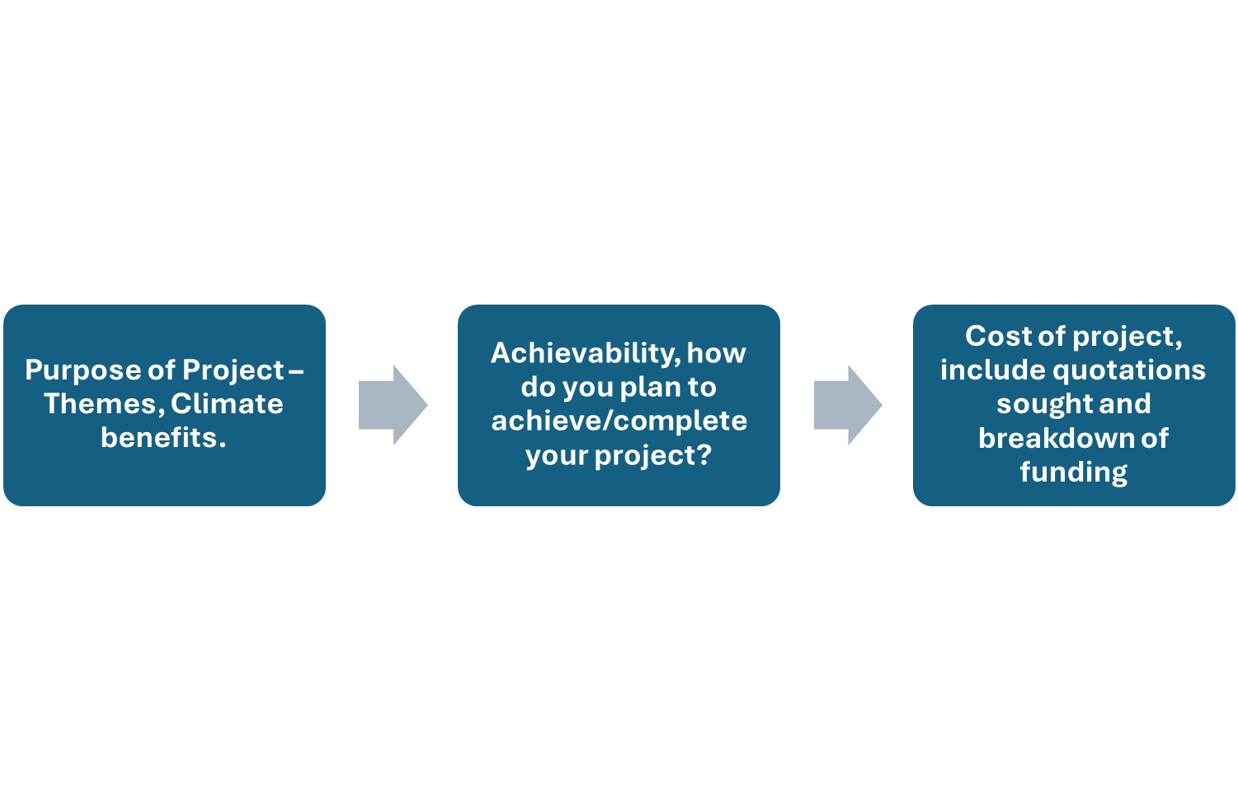
Application Process Overview
- Details About Your Project

Slide 14
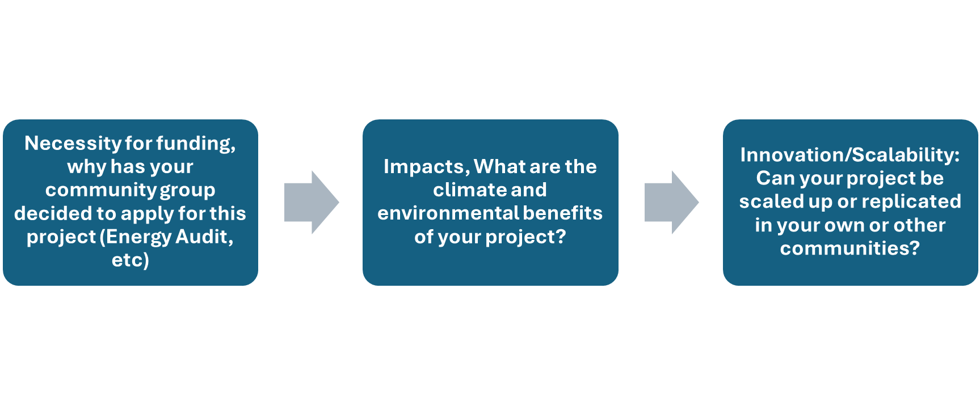
Application Process Overview
- Details About Your Project

Slide 15
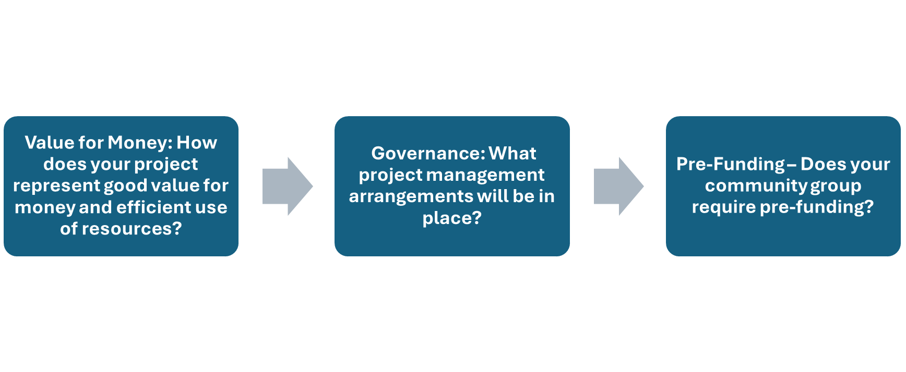
Application Process Overview
- Details About Your Project

Slide 16
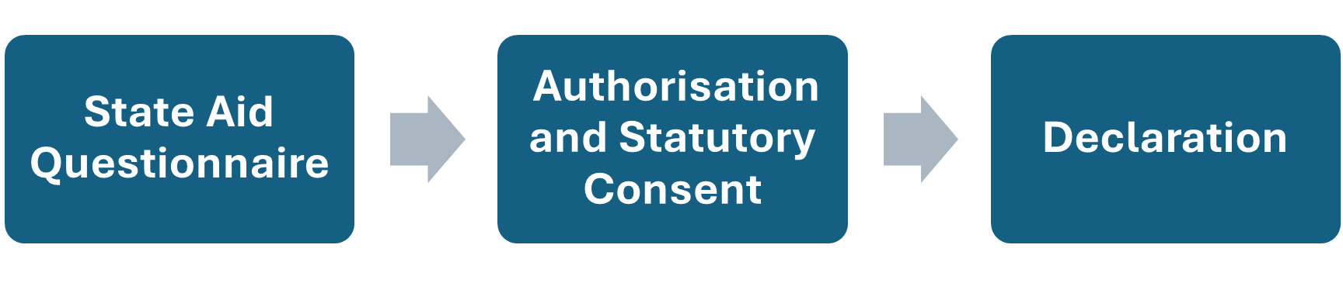
Application Process Overview

Slide 17
Community Climate Action Officer Contacts:
Kildare: Stephen O’Reilly climateactionoffice@kildarecoco.ie
Louth: Fiona Lennon climateaction@louthcoco.ie
Meath: Angela Loughran climateactionmcc@meathcoco.ie
Wicklow: Julie Sammiller jsammiller@wicklowcoco.ie

Slide 18
Community Climate Action Programme

